Slide 1

BRYAN WRIGHT
FOUNDER AND OWNER
Dynamicfamilysolutions.net

Slide 2
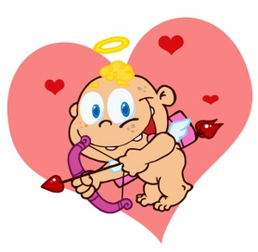

Do relationships start off bad?
HONEYMOON PHASE

Slide 3
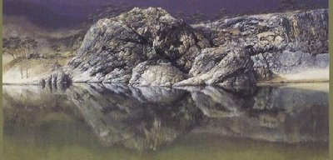
Relationships are seen…

Slide 4
WHAT IS UNDER THE SURFACE?
NEVER
taught
about
Healthy relationships
Accept
as NORMAL

Slide 5
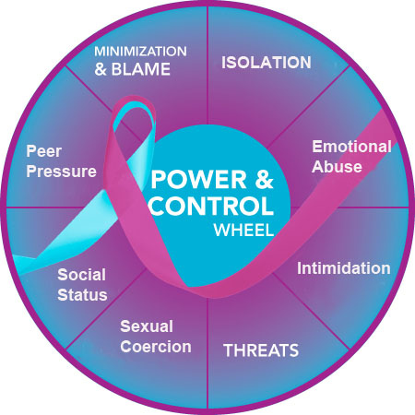
POWER AND CONTROL
8 TYPES OF ABUSE
YOUR VOICE
AND YOUR
OPINION
MATTER
RELATIONSHIPS
EQUALITY
50/50
YOU HAVE
A SAY IN WHAT HAPPENS
IT’S NOT YOUR
FAULT IF THESE
THINGS ARE
HAPPENING

Slide 6

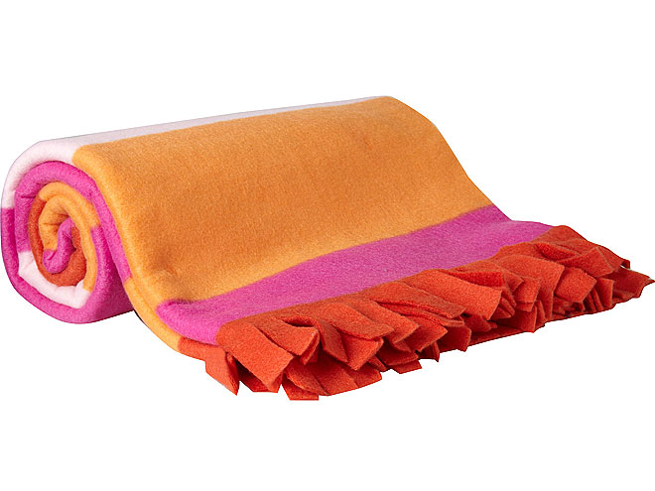
HONEYMOON PHASE
LOVE
I
I
JEALOUSY
I
I
TRUST

Slide 7

ISOLATION
CALL OR TEXT 20-30 TIMES IN AN HOUR
WHERE THEY ARE
WHO THEY ARE WITH / WHAT THEY ARE DOING
WANT TO KNOW ALL OF THE PASSWORDS:
EMAIL, CELL PHONES, FACEBOOK ANYTHING
START NOTICING FRIENDS, FAMILY DISAPPEARING

Slide 8

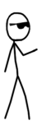
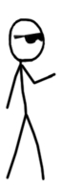


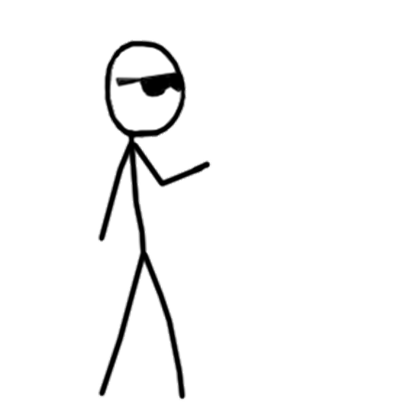
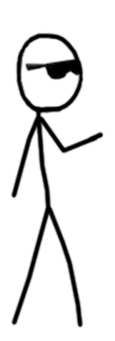
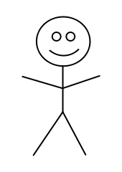
EMOTIONAL
ABUSE
PROPHECY FULFILLED
Self-fulfilling
Prophecy

Slide 9

Minimize Deny and Blame
YOU
Unearned Guilt
Big or Small
Who Will be Blamed?
Someone Else’s
Actions Cause you
To Feel Guilty.
98% WILL NOT CHANGE

Slide 10

HONEYMOON
LOVE
HOPE
FEAR
EXPLOSION
TENSION

Slide 11
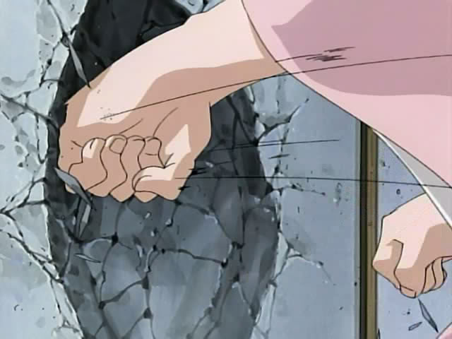
EXPLOSION
THREATS
INTIMIDATION
Biggest threat we hear?
Yelling
Hurtful looks
Breaking belongings
Punching the walls
SUICIDE

Slide 12
SEXUAL COERCION
PEER PRESSURE
FORCED, COERCED,
OR MANIPULATED
If something doesn’t feel right….
Don’t do it!
LADIES
Don’t use your body.
It’s still rape
Drunk
Same age
Under 18
GUYS
Stop using emotions to get physical.

Slide 13
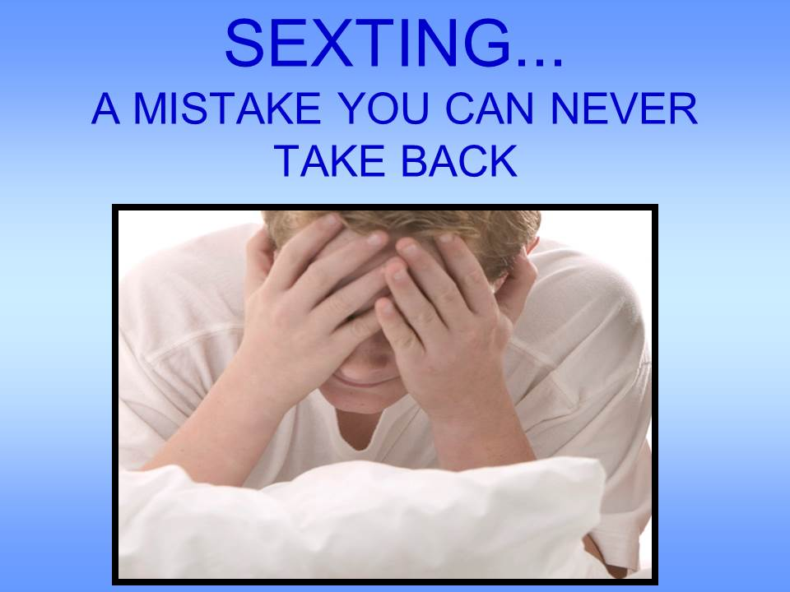
SEXTING
Possession = Child pornography
If you share = Soliciting child porn
Snap chat doesn’t get rid of the pic nor does deleting it

Slide 14


SOCIAL STATUS
Nobody would have even known who you are if it wasn’t for me!
You think anyone is going to want to hangout with you if you break up with me.
You wouldn’t even know half of these people if it wasn’t for me!
Look at you and look at me you are nothing without me!

Slide 15


SOCIAL STATUS
Leave me and everyone will know how much of a slut you are.
I’d rather be hurt and feel like
I belong than be alone.
Poor, pathetic and weak.
Where you going to go?
I’ve given you everything!
You wouldn’t have half the stuff you do if it wasn’t for me!

Slide 16

ANY QUESTIONS?

